Slide 1
SECTION 10.3: 8051 SERIAL PORT PROGRAMMING IN ASSEMBLY
11.0592 MHz XTAL oscillator

Slide 2
SECTION 10.3: 8051 SERIAL PORT PROGRAMMING IN ASSEMBLY
SBUF (serial buffer) register
a byte of data to be transferred via the TxD line must be placed in the SBUF register
SBUF holds the byte of data when it is received by the RxD line
can be accessed like any other register
MOV SBUF,#'D' ;load SBUF=44H, ASCII for 'D‘
MOV SBUF,A ;copy accumulator into SBUF
MOV A,SBUF ;copy SBUF into accumulator
when a byte is written, it is framed with the start and stop bits and transferred serially via the TxD pin
when the bits are received serially via RxD, it is deframe by eliminating the stop and start bits, making a byte out of the data received, and then placing it in the SBUF

Slide 3
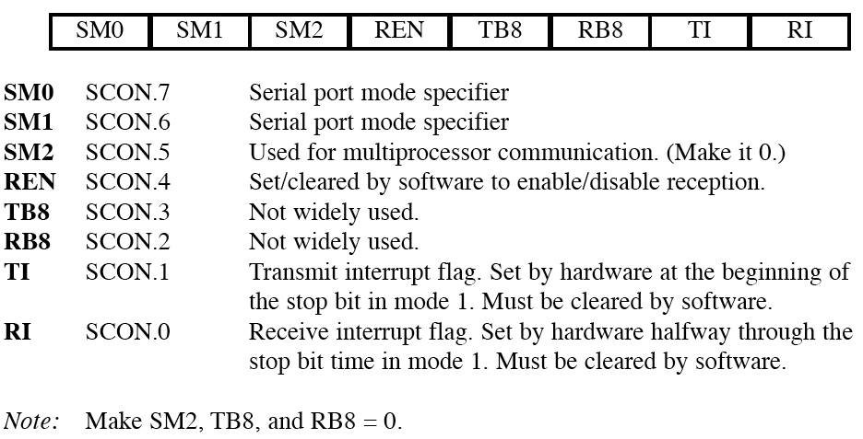
SECTION 10.3: 8051 SERIAL PORT PROGRAMMING IN ASSEMBLY
SCON (serial control) register
to program the start bit, stop bit, and data bits
Figure 10–9 SCON Serial Port Control Register (Bit-Addressable)

Slide 4
SECTION 10.3: 8051 SERIAL PORT PROGRAMMING IN ASSEMBLY
SM0 and SM1 determine the mode
only mode 1 is important
when mode 1 is chosen, the data framing is 8 bits, 1 stop bit, and 1 start bit
compatible with the COM port of PCs
mode 1 allows the baud rate to be variable and is set by Timer 1 of the 8051
for each character a total of 10 bits are transferred, where the first bit is the start bit, followed by 8 bits of data, and finally 1 stop bit.

Slide 5
SECTION 10.3: 8051 SERIAL PORT PROGRAMMING IN ASSEMBLY
REN (receive enable)
REN=1, allows 8051 to receive data on the RxD
if 8051 is to both transfer and receive data, REN must be set to 1
REN=0, the receiver is disabled
SETB SCON.4 and CLR SCON.4,

Slide 6
SECTION 10.3: 8051 SERIAL PORT PROGRAMMING IN ASSEMBLY
TI (transmit interrupt)
when 8051 finishes the transfer of the 8-bit character, it raises the TI flag to indicate that it is ready to transfer another byte
RI (receive interrupt)
when the 8051 receives data serially via RxD, it places the byte in the SBUF register
then raises the RI flag bit to indicate that a byte has been received and should be picked up before it is lost

Slide 7
SECTION 10.3: 8051 SERIAL PORT PROGRAMMING IN ASSEMBLY
Program to transfer data serially
TMOD register is loaded with the value 20H
TH1 is loaded with value to set the baud rate
SCON register is loaded with the value 50H
TR1 is set to 1 to start Timer1
TI is cleared by the "CLR TI" instruction
transmit character byte is written into the SBUF register
TI flag bit is monitored to see if the character has been transferred completely
to transfer the next character, go to Step 5.

Slide 8
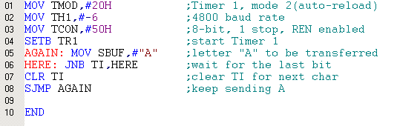
Example 10-2 Write a program to transfer letter "A" serially at 4800 baud, continuously. (Error in line 3 – should be SCON)

Slide 9
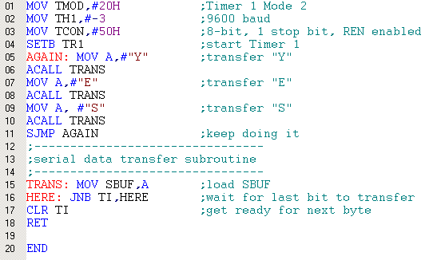
Example 10-3 Write a program to transfer the message "YES" serially at 9600 baud, 8-bit data, 1 stop bit. Do this continuously. (Error in line 3 – should be SCON)

Slide 10
SECTION 10.3: 8051 SERIAL PORT PROGRAMMING IN ASSEMBLY
Importance of the TI flag
check the TI flag bit, we know whether can transfer another byte
TI flag bit is raised by the 8051
TI flag cleared by the programmer
writing a byte into SBUF before the TI flag bit is raised, may lead to loss of a portion of the byte being transferred

Slide 11
SECTION 10.3: 8051 SERIAL PORT PROGRAMMING IN ASSEMBLY
Program to receive data serially
TMOD register is loaded with the value 20H
TH1 is loaded with value set the baud rate
SCON register is loaded with the value 50H
TR1 is set to 1 to start Timer 1
RI is cleared with the "CLR RI" instruction
RI flag bit is monitored to see if an entire character has been received yet
RI=1 SBUF has the byte, its contents are moved into a safe place
to receive the next character, go to Step 5

Slide 12
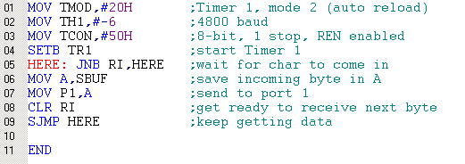
Example 10-4 Program the 8051 to receive bytes of data serially, and put them in P1. Set the baud rate at 4800, 8-bit data, and 1 stop bit. (Error in line 3 – should be SCON)

Slide 13
SECTION 10.3: 8051 SERIAL PORT PROGRAMMING IN ASSEMBLY
Importance of the RI flag bit
it receives the start bit, next bit is the first bit of the character
when the last bit is received, a byte is formed and placed in SBUF
when stop bit is received, makes RI = 1
when RI=1, received byte is in the SBUF register, copy SBUF contents to a safe place
after the SBUF contents are copied the RI flag bit must be cleared to 0

Slide 14

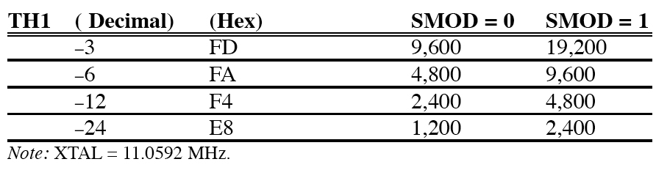
SECTION 10.3: 8051 SERIAL PORT PROGRAMMING IN ASSEMBLY
Doubling the baud rate in the 8051
two ways to increase the baud rate
Use a higher-frequency crystal
Change a bit in the PCON register
Table 10–5 Baud Rate Comparison for SMOD = 0 and SMOD = 1

Slide 15
SECTION 10.3: 8051 SERIAL PORT PROGRAMMING IN ASSEMBLY
Interrupt-based data transfer
it is a waste of the microcontroller's time to poll the TI and RI flags
to avoid wasting time, use interrupts instead of polling

Slide 16
Next …
Lecture Problems Textbook Chapter 10
Answer as many questions as you can and submit via MeL before the end of the lecture.
Proteus Exercise 9
Do as much of the Proteus exercise as you can and submit via MeL before the end of the lecture.

